Slide 1
SS, NPS, Atal Pension
Insurance: Theory & Types
Insurance: History & Nationalization
IRDA, Powers
Public sector insurance Co.
Fin. Inclusion:
PM JJ & Surksha
Intermediaries & Ombudsman
49% FDI: Pro-Cons

Slide 2
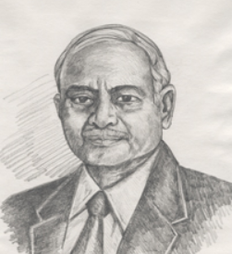
Malhotra Committee
1993-94
SEBI like statutory body for insurance sector: IRDA
1996: setup
1999: Insurance regulatory and Development authority act passed
2000: President Signed.

Slide 3
Amendment Bill, 2015
Insurance act, 1938
General insurance (Nationalization), 1972
IRDA Act, 1999
Name changed to IRDAI
Insurance regulatory and Development authority of India
Govt. ownership can be reduced to 51%

Slide 4
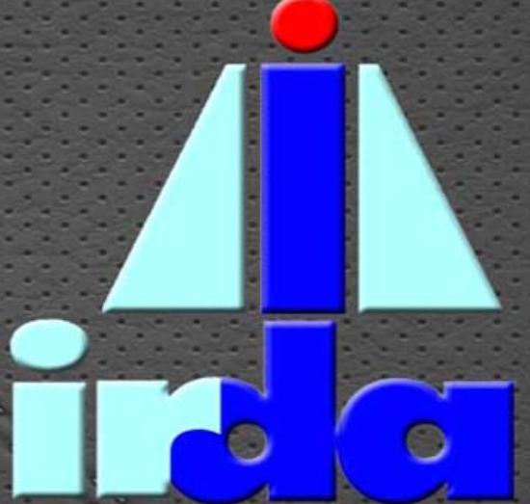
10 people re-appoint: Yes
IRDA
Chairman
5 Fulltime
4 Parttime
5 yr / 62 age
5 yr / 65 age

Slide 5
structure
IRDAI
10 people- Experience Life Insurance, general Insurance, actuarial science, finance, economics, law accountancy, administration
None can join post-retirement job within 2 years, unless govt. approves.
Removal in bankruptcy, conflict of interest, physical-mental infirmity, punished by court

Slide 6
functions
IRDAI
RBI gave blanket permission to all NBFCs to run insurance business
But they have to get IRDAI registration
IRDAI doesn't have 'quota', but gives separate licenses for life and general insurance.

Slide 7

functions
IRDAI
Member of International association of Insurance Supervisors (IAIS), Basel, Switzerland.
Registration, renewal and regulation of Insurance company.
Withhold, suspend, cancel registration for any violation
Notes:
International coordination, good management practices.

Slide 8

Function accounts monitoring
IRDAI
Monitor accounting procedures, fees-rates, commissions, solvency.
Cos. have to maintain separate accounts on receipts and payments
Insurance company has to keep expenses within the limits set by IRDAI.
Companies can't give unauthorized commissions to agents Else monetary fines

Slide 9
Function accounts monitoring
IRDAI
IRDAI appointed official to monitor capital requirements.
IRDAI can investigate company and its middlemen
Company can appeal against above @Securities Appellate Tribunal(SAT)

Slide 10
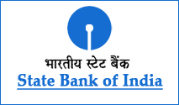
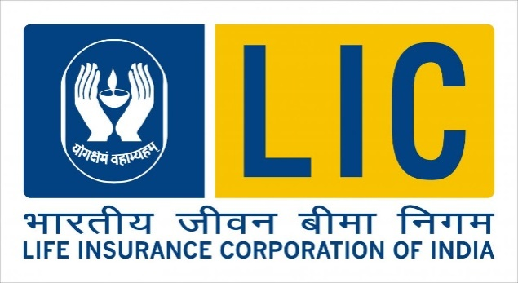

Backup / emergency / safety?
Bank
CRR
CAR (Cap. adequacy ratio, BASEL)
Insurance
SLR
Investment pattern
Solvency Margin
Notes:
Solvency margin
Extra capital, the company must hold against unforeseen exigencies.
Previously: deposit @RBI during registration, Now just maintain deposit with IRDAI.

Slide 11
Malhotra Committee
1993-94
LIC’s compulsory investment in G-Sec: 50% only 15%

Slide 12
Investment pattern
Life insurance
Min. 15%
RBI Reverse repo
Commercial Papers
AA rated Shares / debentures
Min. 25%
Hosing and Infra bonds.
Max. 20% “Approved” investment
G-Sec
Remaining – other investment
On October 2014
75% debt investment in AAA or sovereign
Not less than 5% below “A”.
Notes:
http://investments.ifmr.co.in/wp-content/uploads/2014/06/FInclusion-55-Investment-Guidelines-for-Insurance-Companies.pdf

Slide 13

Investment pattern
GI
Union: 20%
Min. 5%
Min. 10%
Max.70% “Approved” investment
RBI Reverse repo
Commercial Papers
AA rating Shares / debentures
G-Sec (Min.)
States / other approved: 30%
Loan to states for housing and fire fighting eqp.
Social sector infrastructure

Slide 14
Correct statement
Which of the following is/ are required to invest in government securities compulsorily?
Merchant Banks
Commercial Banks
Investment Banks
Life insurance companies
Notes:
(a) Cash or (b) Gold valued at a price not exceeding the current market price, or (c) Investment in the following instruments which will be referred to as "Statutory Liquidity Ratio (SLR) securities":
(i) Dated securities issued up to May 06, 2011as listed in the Annex to Notification DBOD.No.Ret.91/12.02.001/2010-11 dated May 09, 2011;
(ii) Treasury Bills of the Government of India;
(iii) Dated securities of the Government of India issued from time to time under the market borrowing programme and the Market Stabilization Scheme;
(iv) State Development Loans (SDLs) of the State Governments issued from time to time under the market borrowing programme; and
(v) Any other instrument as may be notified by the Reserve Bank of India.

Slide 15
Benefits/Criticism of Insurance Amendment
Accountability
Will improve
BoP / infra. Investment
Will not improve
Will improve
Will not
Rural penetration
Will Happen
Will not Happen

Slide 16

How FDI improve infra?
Amendment
Capital account surplus => boost Forex reserve => project loans (L6P2.pptx)
Stability in financial market, exchange rates = more investors attracted to GIFT city- international banking, pension, infrastructure bonds
Insurance penetration ▲ = boost in infra. Projects finance- like Bibek Debroy and Economic survey wanted

Slide 17
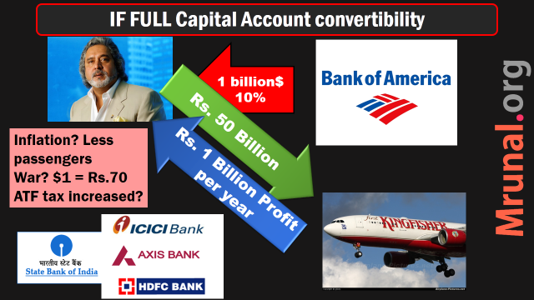
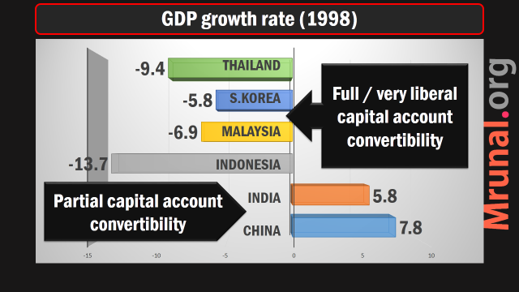
FDI->BoP criticism
Amendment
Rajan planning to relax capital account convertibility.
49% (FDI+FII)=> sudden $$ flow may destabilize financial market
Because FII volatile
More: L3P2.pptx

Slide 18
SS, NPS, Atal Pension
Insurance: Theory & Types
Insurance: History & Nationalization
IRDA, Powers
Public sector insurance Co.
Fin. Inclusion:
PM JJ & Surksha
Intermediaries & Ombudsman
49% FDI: Pro-Cons

Slide 19
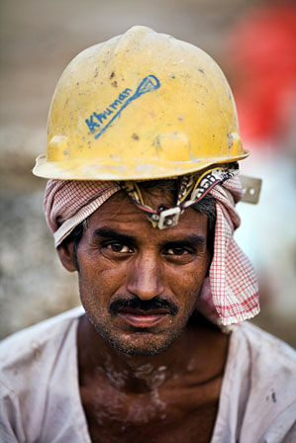
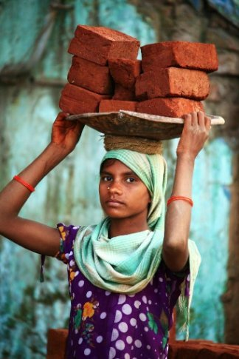
Financial inclusion?
Bank
PSL norms
Insurance
25% Rural branching mandate
Rural & social obligation

Slide 20
Rural and social obligation
Rural Area
Social
Rules
5k lives in 1st Fin.Year
…
25k lives in 10th Financial years
Census
unorganized workers, backward, PH, Poor

Slide 21
Malhotra Committee
1993-94
Rural areas: postal life insurance to continue
Ensure Rural penetration of insurance products through public & private companies (one of the justification for allowing private companies)

Slide 22
Benefits/Criticism of Insurance Amendment
Accountability
Will improve
BoP / infra. Investment
Will not improve
Will improve
Will not
Rural penetration
Will Happen
Will not Happen

Slide 23

Will help in penetration
amendment
India 3.2% premium / GDP. Jap 10%, Aussies: 6%
LIC controls 70% market.
Till now Private 26% FDI but unable to raise funds for expansion.
Only 17/24 insurance cos. Making profit. (data may be outdated)
Others have neither money / technology to handle business efficiently.
49% FDI = Insurance companies increased- competition = better products, services, more jobs - direct and indirect.

Slide 24
Will help in penetration
amendment
More capital= economies of scale = cheaper operations, cheaper policies.
New products for lower income groups, MSME, SHG, unorganized sector.
Insurance policy can be used as collateral for borrowing = big relief to farmers and small businessmen.
The Pension Fund Regulatory Development Bill links the Pension-FDI to Insurance sector. So, 49% to pension sector as well. = its angles in financial inclusion

Slide 25
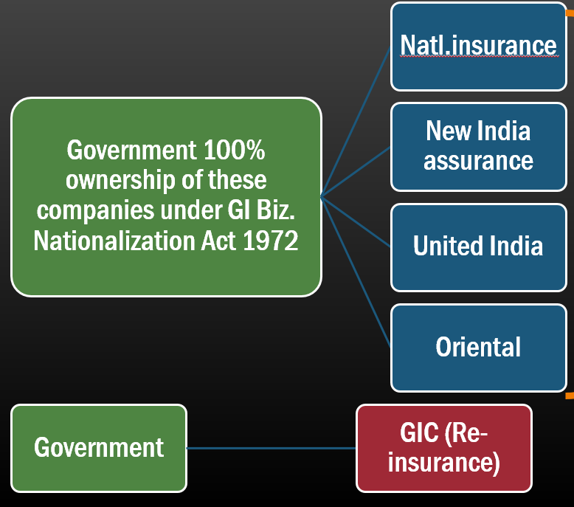
Sarkari GI companies
Amendment
General insurance (Nationalization) Act : 4 general insurance companies were 100% Government owned
Public sector insurance companies can raise capital but Government shareholding must not decline below 51%
So, those 4 can issue IPO/FPO to get funds for further rural expansion / penetration

Slide 26
FDI=>Rural penetration criticism
Amendment
Existing provisions for rural / social obligation kept but No new addl. Safeguards for rural penetration. So 49% FDI unlikely to benefit Indian poor.
Counter: FDI => private companies catering urban middle class => public insurance cos. & their agents will have to Fall back to rural areas=> penetration increased.

Slide 27
Benefits/Criticism of Insurance Amendment
Accountability
Will improve
BoP / infra. Investment
Will not improve
Will improve
Will not
Rural penetration
Will Happen
Will not Happen
Has Government done anything?
Microinsurance, PM JJ/S

Slide 28

Micro-insurance
insurance
for poor / villagers / farmers
Life / General Insurance policy
Small sum insured (50k or less), Low premium
Premium Return: with / without.
Cover: individual / group
Intermediaries: NGO, SHG, MFI
AGENT: no edu. qualification, no exam.
Policy/ Contracts must be given in local language

Slide 29


Modi: 2 insurance schemes for वित्तीय समावेशन
PM Jeevan Jyoti Bima PMJJBY
PM Suraksha Bima PMSBY
Validity 1 year (1st June to 31st May)
Same
Life insurance
Death by any reason
Accidental death/disability
Natural death

Slide 30

Modi: 2 insurance schemes: how much $$?
PM Jeevan Jyoti Bima
PM Suraksha Bima
2 lakh
Death by any reason
2 lakh for death
2 lakh if both eyes, hands, legs gone
1 lakh if 1 eye,hand,leg gone.

Slide 31

Modi: 2 insurance schemes- PREMIUM
PM Jeevan Jyoti Bima
PM Suraksha Bima
Rs.289 insurance
Rs.30 Agent
Rs. 11 Bank
=Total 330 pa/per person
Rs.10 Insurance
Rs.1 Agent
Rs.1 Bank
Rs.12 pa/ Per person

Slide 32


How to memorize trivial factoids for MCQs?
Saif Paid Rs.12 premium
Got Rs. 1 lakh when he became Langda Tyagi
(for only 1 leg lost)
R= 12
Notes:
Some type of Chhichhorpanti is necessary to memorize factoids

Slide 33

Modi: 2 insurance schemes- Eligibility?
PM Jeevan Jyoti Bima
PM Suraksha Bima
18-50 yo savings account holder
If multiple account- only 1 eligible
18-70
Premium auto-debit
Others same

Slide 34

Modi: 2 insurance schemes: implementation?
PM Jeevan Jyoti Bima
PM Suraksha Bima
LIC & other insurance companies
Public and private general insurance companies

Slide 35

Modi 3 schemes
Criticism
Cover / Pension insufficient in this age of inflation
No tax benefits on Atal pension.
Counter: middle class can opt for higher products
These 3 only for bottom strata of the society.
If junta’s insurance/pension habit cultivated => Fiscal deficit ▼

Slide 36
SS, NPS, Atal Pension
Insurance: Theory & Types
Insurance: History & Nationalization
IRDA, Powers
Public sector insurance Co.
Fin. Inclusion:
PM JJ & Surksha
Intermediaries & Ombudsman
49% FDI: Pro-Cons

Slide 37
Insurance intermediaries: 5 Types
Agents / Corporate Agents
Third Party Administrators
Brokers
Surveyor/ Loss Assessor
Banks (Bancassurance)

Slide 38
Intermediary: AGENTs and Brokers
Agent
Only 1 LI, 1HI, 1GI
Corporate Agent
Only 1 LI, 1HI, 1GI
Broker
Multiple products
10 pass (R), 12 pass (U)
Training
Exam: insurance institute of India
Registration: controller of insurance, under 1938 ACT
Banks
NBFCs
Need Min. 50L To 250L capital depending on product category
Bancassurance
favored model
Notes:
Insurance Amendment: puts all in one category of “Insurance intermediaries”
Pro: more choices to client, professional advice, less “target-misselling”
Anti: MoU have to be scrapped, bank staff not trained for multiple companies policies

Slide 39
Bancassurance
intermediaries
French concept: Using bank-network to sell insurance products
Majority of banks follow corporate agent model
1 bank=> 1LI, 1GI, 1Health
SBI bank=> SBI life insurance, general insurance (+health)
Amendment: IRDA draft rules to allow them to tie up with multiple insurance companies like Brokers.
Pro: benefit to customer, more choice

Slide 40
SBI Bank is “Corporate Agent” of
SBI life insurance
SBI General
SBI
Insurance Australia Group (IAG)
SBI
BNP Paribas Cardif

Slide 41

Intermediaries Agent
IRDAI
Insurance agents: their edu. Qualification, examination and certificate.
Need license to work as insurance intermediaries- else fines. Even Company officers liable if they knew.
Who can't become agents? minors, unsound mind, convicts in frauds, not passing training / exams.
Company must maintain agent database even 5 years after his appointment ends.

Slide 42
Intermediaries Agent
IRDAI
No individual agent shall act as insurance agent for more than 1 life insurer, 1 general insurer, 1 health insurer.
No multi level marketing scheme
Penalties for fraud/mis-selling: 1 crore to 25 crores

Slide 43
Insurance intermediaries: 5 Types
Agents / Corporate Agents
Third Party Administrators
Brokers
Surveyor/ Loss Assessor
Banks (Bancassurance)

Slide 44

Surveyor Loss Assessor
intermediaries
Independent professional
To confirm cause, quantum & liability of loss.
A, B, C category depending on experience and skill.
No. of professional: A < B < C
IRDA- financial limits on each surveyor, else only rubber stamp.

Slide 45
Intermediaries Surveyor
IRDAI
Surveyor / Loss Assessor must be member of Indian Institute of Loss Assessors and Surveyors(IIISLA),
He must follow IRDA norms and code of conduct.
Notes:
Code of conduct for surveyors and loss assessors.- their classification in A,B,C category depending on experience and skill.

Slide 46
Claim settlement
Amendment
% Claim rejected: LIC: 1.12%, private: 7.85%
New amendment: Private cos. Permitted to ‘outsource’ inspection and claim-settlement to 3rd parties.
So problem may aggravate
Counter: client can complaint to insurance ombudsman, IRDA can inspect-> SAT appeal

Slide 47
Insurance intermediaries: 5 Types
Agents / Corporate Agents
Third Party Administrators
Brokers
Surveyor/ Loss Assessor
Banks (Bancassurance)

Slide 48
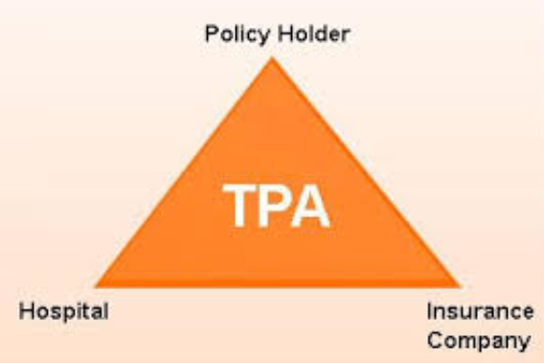
3rd Party Admin.
Intermediaries
In healthcare biz.
Manage “mediclaim policies”: Link client, hospitals, pharmacies, run 24/7 helplines
Can tieup with >1 insurance co.
Min. capital: 1 cr, license renew every 3 years, ~5.5% commission from premium (data may be outdated)
Poor service quality =clients not renewing

Slide 49
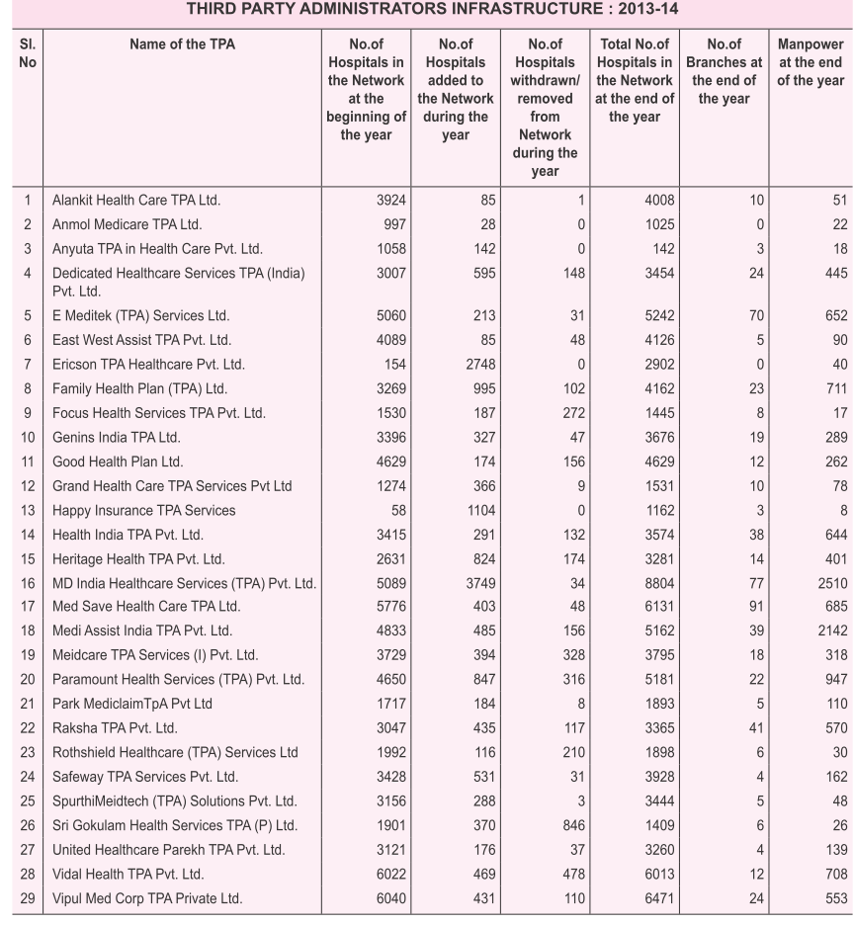

Slide 50
Alternate Distribution Channels
Direct marketing
ICICI prudential (Life) direct flyers in lunchboxes, Mumbai
Automobile showrooms/ Cos.
Direct tie up for vehicle insurance
Forex dealers
Thomas cook, Western Union – for intl. travel insurance
Cargo
Outlets
Internet, policybazzar.com, Malls / stores
Marine - Airline: / shipping companies

Slide 51

Insurance council
Amendment
Insurance act 1938- provided for Insurance association of India.
but separate councils also permitted.
2001: IRDA setup Life Insurance Council and General Insurance Council
They’re made self-regulating bodies, with power to frame election-laws, meetings, collect fees from members.
Even SHG and cooperative society representation

Slide 52

Tariff advisory Committee
General ins.
Insurance Act 1938, statutory body
Pricing of general insurance products, solvency margin
fixes “tariff slabs”
De-tariffing : pricing negotiable based on international trends / client’s business.
2007: all GI “De-tariffed” except 3rd party motor (Liberalization)
Notes:
Mechanism not important, but this is also one type of liberalization.

Slide 53
SS, NPS, Atal Pension
Insurance: Theory & Types
Insurance: History & Nationalization
IRDA, Powers
Public sector insurance Co.
Fin. Inclusion:
PM JJ & Surksha
Intermediaries & Ombudsman
49% FDI: Pro-Cons

Slide 54

Customer ease / protection
IRDAI
company has to display 'online premium calculator' on site
must have separate mechanism for grievances redressal.
Companies to Issue polices in electronic / dematerialized form (L2/P2.pptx)
IRDA to decide norms for surrendering insurance policy.

Slide 55
Insurance grievances redressal
Consumer courts
District: upto 20 lakh
State: >20L upto 2 crores
National: >2 crores
Civil Court
Inhouse
ombudsman

Slide 56
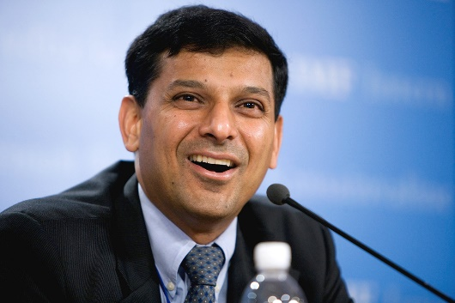

Banking Ombudsman
Insurance Ombudsman
Customer complaints against bank
From UK => India 1995
RBI’s general managers => 3 years => No reappointment
Except J&K
Insurance Act=> Government made redressal of public grievances (RPG) rules
1999: insurance council => 12 ombudsman in India

Slide 57
Banking Ombudsman
Insurance Ombudsman
Matters upto 10 lakh
All banks and loan giving NBFCs
Hear matters upto 20 lakh
Conciliation and award making – binding on company

Slide 58

How about protecting company from client?
Amendment
A life insurance policy may be called in question within 3 years on the grounds misstatement or suppression of facts
Criticism: What if fraud discovered after 3 years? Company will have to pay client even if he’s fraud
Notes:
6. Life insurance Policy can be called in question within 3 years on the ground that any statement of or suppression of a fact material to expectancy of life of the insured was incorrectly made in the proposal or other document basis which policy was issued or revived or rider issued. For this, the insurer should communicate in writing to the insured or legal representative or nominee or assignees of insured, as applicable, mentioning the ground and materials on which decision to repudiate the policy of life insurance is based.

Slide 59
SS, NPS, Atal Pension
Insurance: Theory & Types
Insurance: History & Nationalization
IRDA, Powers
Public sector insurance Co.
Fin. Inclusion:
PM JJ & Surksha
Intermediaries & Ombudsman
49% FDI: Pro-Cons

Slide 60
Mains / Interview
Discuss the importance of Insurance amendments bill 2015 in bringing a framework for greater innovation, competition and transparency in Insurance sector of India.

Slide 61
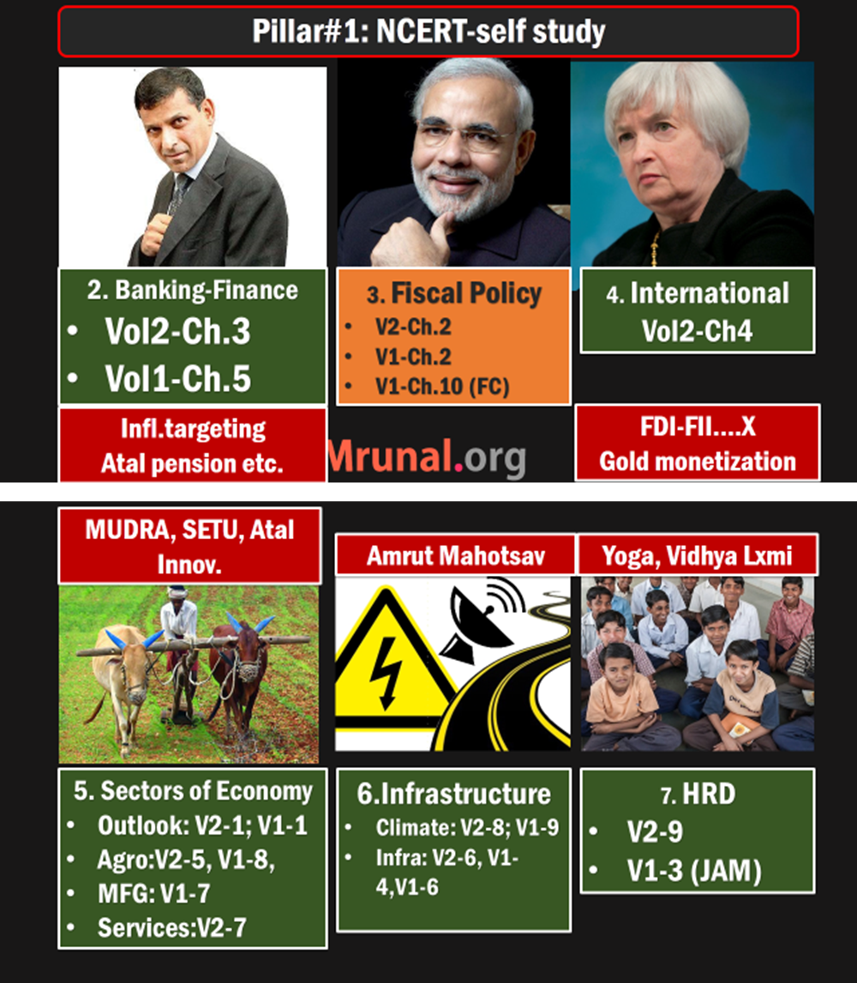
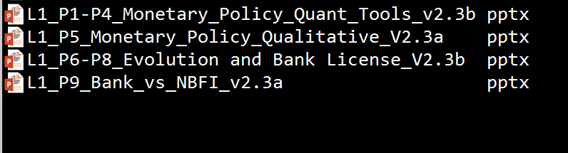

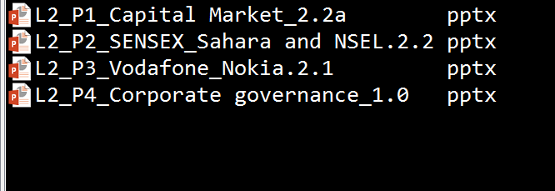
L2/P5 and P6= Insurance
L2/P7…Bank-Finance- reforms, BASEL, 2x financial repression

